Slide 1
Team Awesome

Slide 2

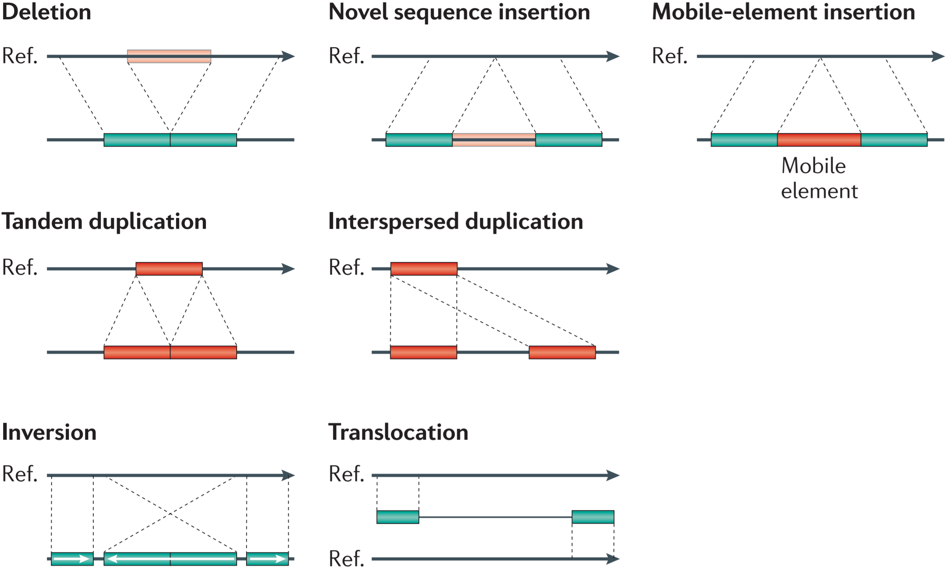



PASS
only
16,822
6,110
5,102
Less than
1,000,000 bp
exonic
3,795
3,243
188
5,021

